Slide 1
Towards predicting the phonons of 2D quantum devices
Laura Rintoul

Slide 2
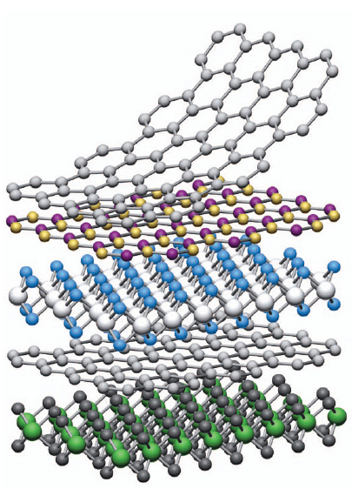
Motivation
Phonons are highly influential on behaviour
Interest in 2D devices
More challenging to extract 2D dispersion than 3D
Geim, A. K. & Grigorieva, I. V. Van der Waals heterostructures.Nature499,419–425.issn:1476-4687.https://doi.org/10.1038/nature12385(2013).
Notes:
Phonons impact conductivity: phonon broadening, impacting qbit performance, emission and absorption

Slide 3
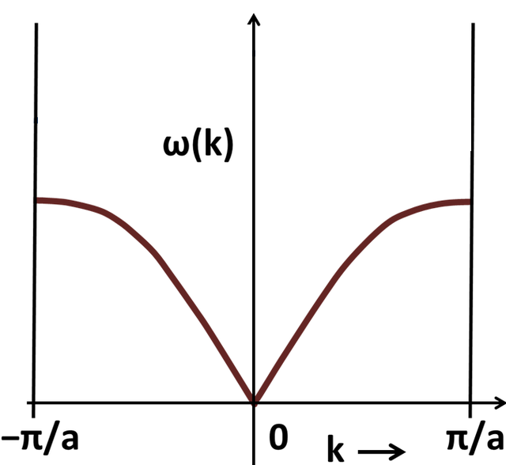
Aim
Develop tools for solving phonon dispersion
Test against 1D example and observe behaviour

Slide 4
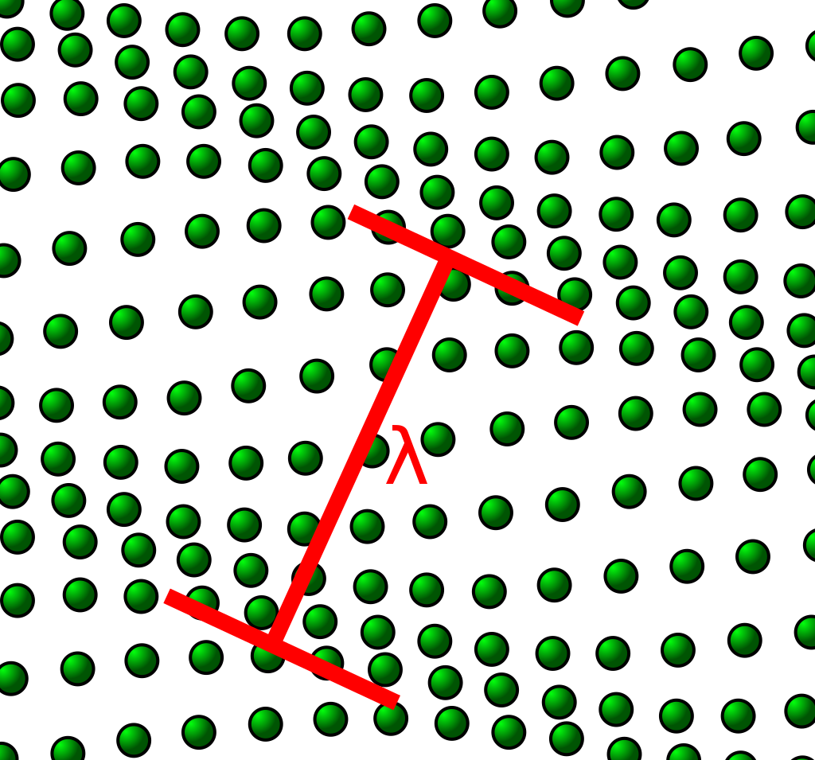
What are phonons?
Vibrations in solid state matter
Description as waves
Dispersion graphs illustrate relationship between wavenumber and k vector

Slide 5
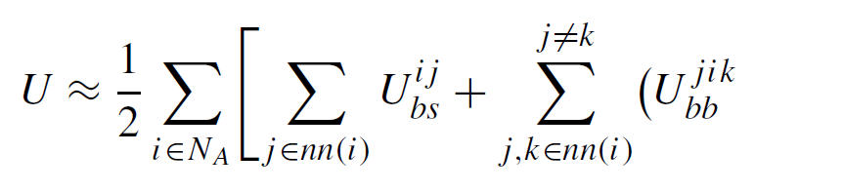
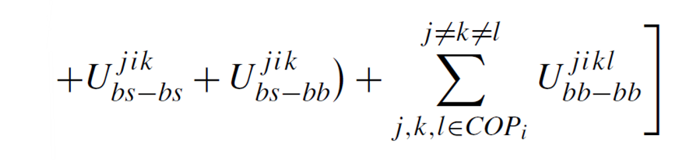
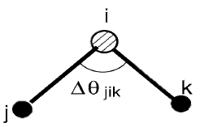
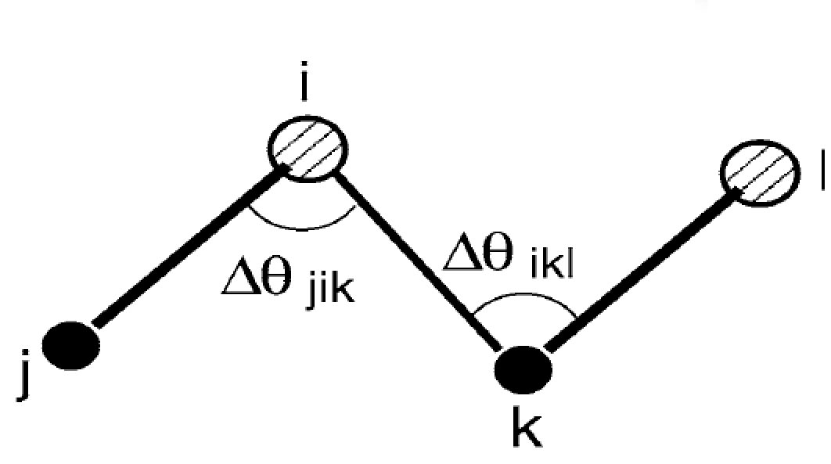
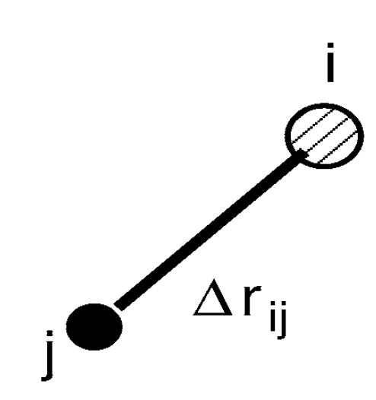

Base MVFF equation
Paul, A., Luisier, M. & Klimeck, G. Modified valence force field approach for phonon dispersion: from zinc-blende bulk to nanowires.Journal of Computational Electronics(2010).

Slide 6
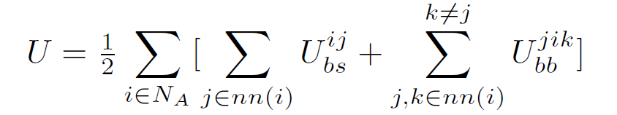
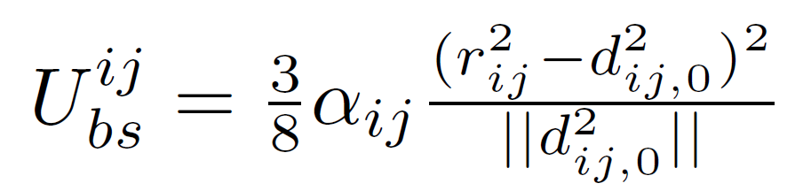
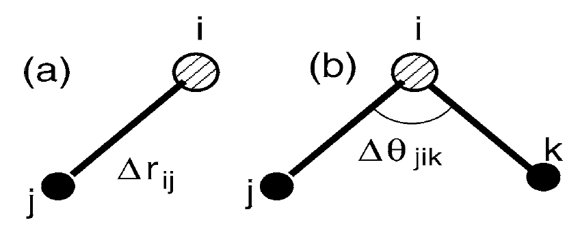
Modified form

Slide 7
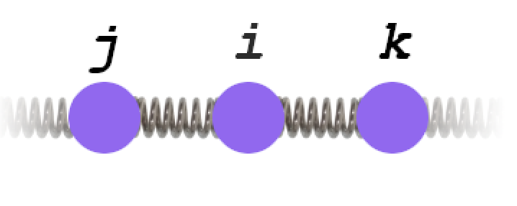
What does this mean for 1D chain computation?
For every point in chain, contribution from nearest neighbour bond stretching
For every point in chain, 2 neighboring points contribute to bond bending term
Zero potential at equilibrium

Slide 8
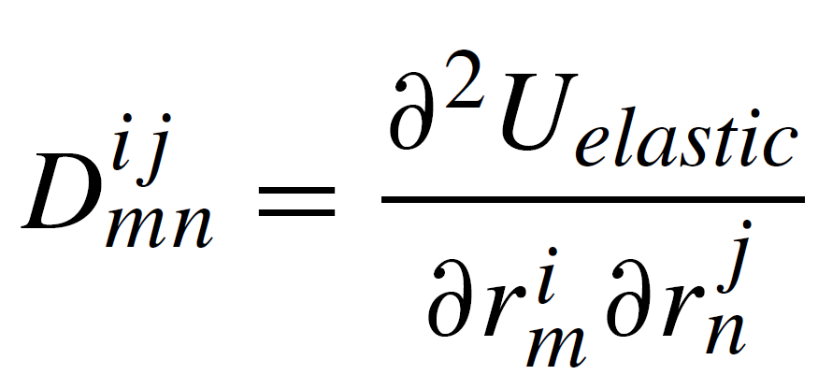
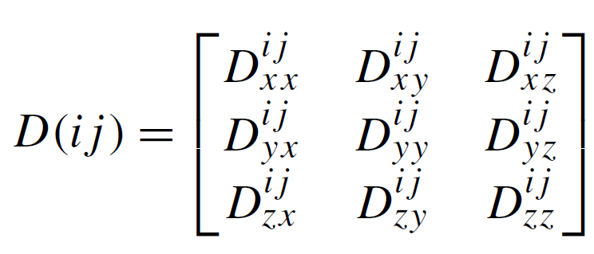
Analytical processing
Analytically computed.

Slide 9
Computation
Program takes in data about lattice
Generates dynamical matrix
Solves
Analytical solution was for any lattice point
Notes:
Explain lattice calculation: program takes in data about

Slide 10
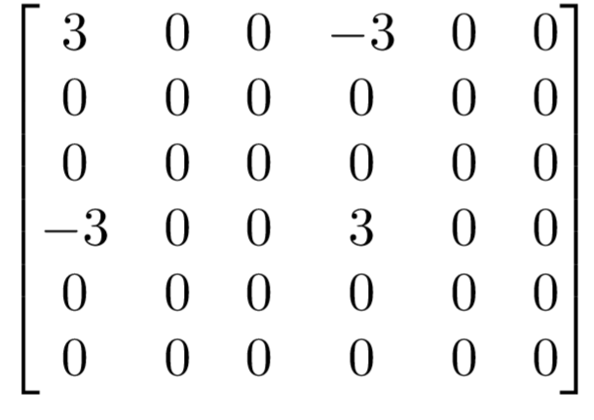
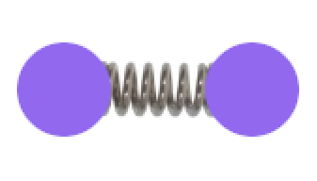
Pair of atoms example dynamical matrix

Slide 11
Classical 2D example
animation: https://en.wikipedia.org/wiki/Phonon#/media/File:1D_normal_modes_(280_kB).gif

Slide 12
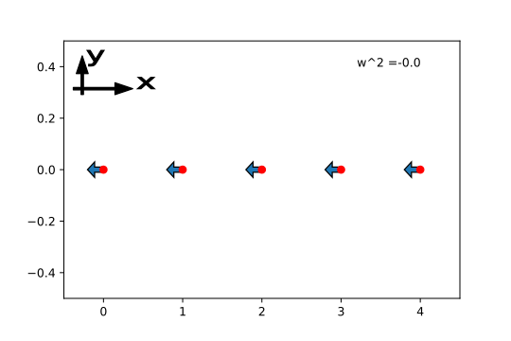
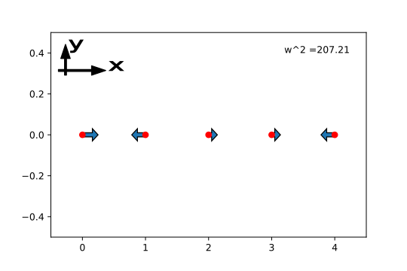
Phonon energies: non-periodic

Slide 13
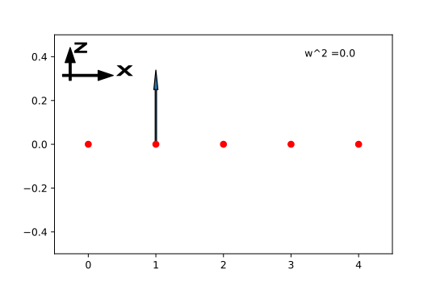
Orthogonal displacement modes
Notes:
2nd order expansion of inner product at 180 degrees gives zero for orthogonal displacements: i.e. this is a logical though surprising result. This would also be obtained if the other terms were included. Bond bending essentially acts as another specific bond bending term in this instance, as angle term is given by inner product as well.

Slide 14
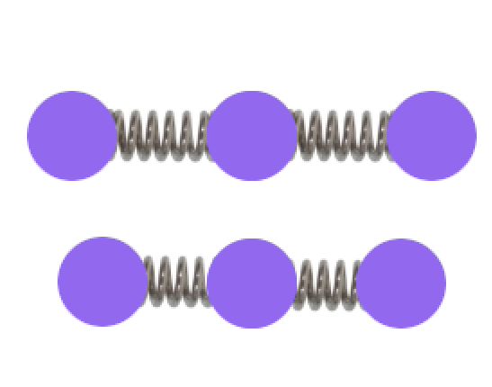


Bond bending term contribution…

Slide 15
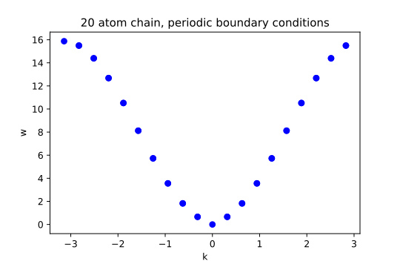
1-dimensional results: periodic case

Slide 16
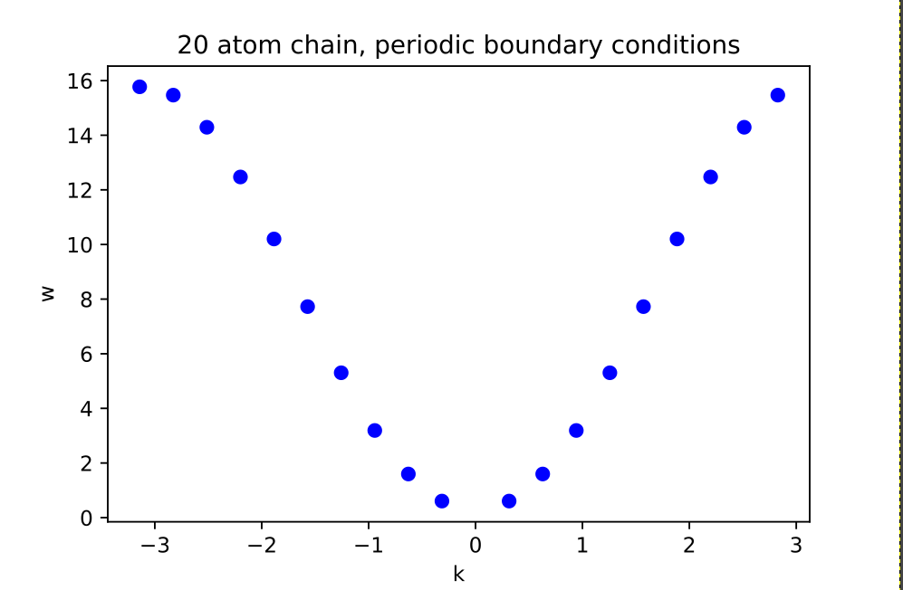
1-dimensional results: finite case

Slide 17
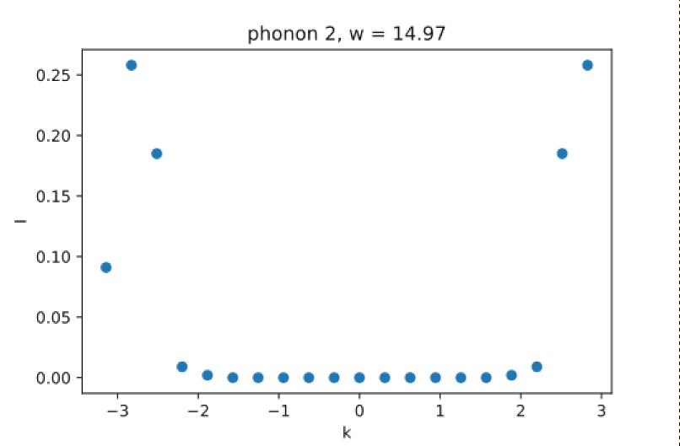
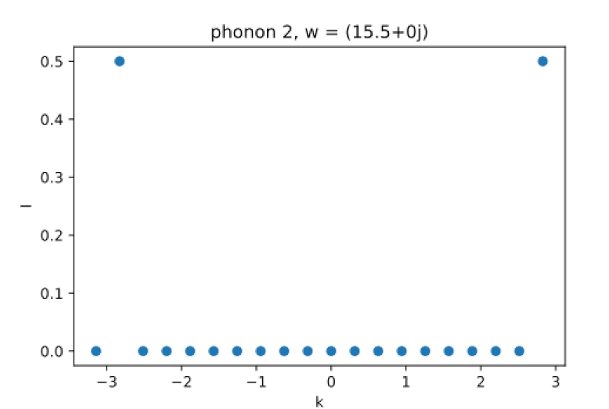
Phonon contribution decomposition
Finite case
Periodic case

Slide 18
Conclusions
Model has been successful in reproducing behaviours for 1 dimensional chains
Has demonstrated the collapse of precise phonons on finite structures
Insight about the limits of a taylor expansion model of potential energy

Slide 19
Further work
Further analysis on mixed mass chains
Observing the optical branch
Extension of this model to 3 dimensional structures and then 2 dimensional structures

Slide 20
Thank you!

